Slide 1
Introduction to
Data Communication &Computer Networks

Slide 2
Outline
The Need For Standards
ISO - Organisation For Standardisation
The OSI Reference Model
A Layered Network Model
The Seven OSI Reference Model Layers
TCP Model
Network Topologies
Examples of Networks

Slide 3
The Need For Standards
Over the past couple of decades many of the networks that were built used different hardware and software
Incompatible and it became difficult for networks using different specifications to communicate with each other
To address the problem of networks being incompatible and unable to communicate with each other, the International Organisation for Standardisation (ISO) researched various network schemes.
The ISO recognised there was a need to create a NETWORK MODEL that would help vendors create interoperable network implementations.

Slide 4

ISO - Organization For Standardization
The International Organisation for Standardisation (ISO)
International standards organisation responsible for a wide range of standards, including many that are relevant to networking.
In 1984 in order to avoid network interconnection without necessarily requiring complete redesign, the Open Systems Interconnection (OSI) reference model was approved as an international standard for communications architecture.

Slide 5
The OSI Reference Model
The model was developed by the International Organisation for Standardisation (ISO) in 1984
The Open Systems Interconnection (OSI) reference model is a descriptive network scheme. It ensures greater compatibility and interoperability between various types of network technologies.
The OSI model describes how information or data makes its way from application programmes (such as spreadsheets) through a network medium (such as wire) to another application programme located on another network.
The OSI reference model divides the problem of moving information between computers over a network medium into SEVEN smaller and more manageable problems .
This separation into smaller more manageable functions is known as layering.

Slide 6
A Layered Network Model
The OSI Reference Model is composed of seven layers, each specifying particular network functions.
The process of breaking up the functions or tasks of networking into layers reduces complexity.
Each layer provides a service to the layer above it in the protocol specification.
Each layer communicates with the same layer’s software or hardware on other computers.
The lower 4 layers (transport, network, data link and physical —Layers 4, 3, 2, and 1) are concerned with the flow of data from end to end through the network.
The upper four layers of the OSI model (application, presentation and session—Layers 7, 6 and 5) are orientated more toward services to the applications.
Data is Encapsulated with the necessary protocol information as it moves down the layers before network transit.

Slide 7
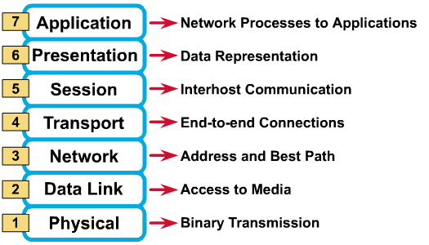
The Seven OSI Reference Model Layers

Slide 8
Division of Layers
7. Application
6. Presentation
Upper Layers
5. Session
4. Transport
Middle Layer
3. Network
2. Data Link
Lower Layers
1. Physical

Slide 9
Layer 7: Application
The application layer is the OSI layer that is closest to the user.
It provides network services to the user’s applications.
It differs from the other layers in that it does not provide services to any other OSI layer, but rather, only to applications outside the OSI model.
Examples of such applications are spreadsheet programs, word processing programs, and bank terminal programs.
The application layer establishes the availability of intended communication partners, synchronizes and establishes agreement on procedures for error recovery and control of data integrity.

Slide 10
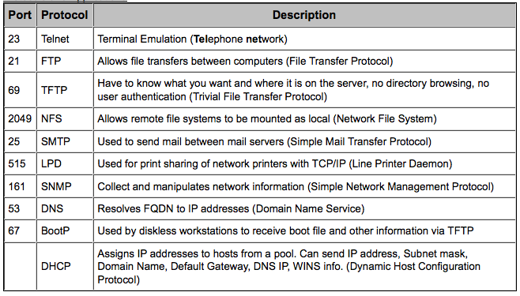
Application Layer Protocols

Slide 11
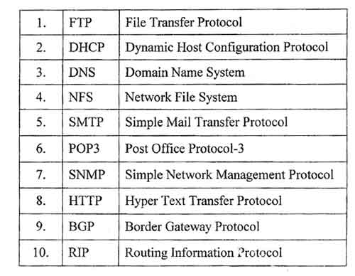

Slide 12
Layer 6: Presentation
The presentation layer ensures that the information that the application layer of one system sends out is readable by the application layer of another system.
If necessary, the presentation layer translates between multiple data formats by using a common format.
Provides encryption and compression of data.
Examples :- JPEG, MPEG, ASCII, EBCDIC, HTML.

Slide 13
Presentation Layer Protocols
Apple Filing Protocol (AFP)
Independent Computing Architecture (ICA), the Citrix system core protocol
Lightweight Presentation Protocol (LPP)
NetWare Core Protocol (NCP)
Network Data Representation (NDR)
Telnet (a remote terminal access protocol)
Tox, The Tox protocol is sometimes regarded as part of both the presentation and application layer
eXternal Data Representation (XDR)
X.25 Packet Assembler/Disassembler Protocol (PAD)

Slide 14
Layer 5: Session
The session layer defines how to start, control and end conversations (called sessions) between applications.
This includes the control and management of multiple bi-directional messages using dialogue control.
It also synchronizes dialogue between two hosts' presentation layers and manages their data exchange.
The session layer offers provisions for efficient data transfer.
Examples :- SQL, ASP(AppleTalk Session Protocol).

Slide 15
Session Layer Protocols
ADSP, AppleTalk Data Stream Protocol
ASP, AppleTalk Session Protocol
H.245, Call Control Protocol for Multimedia Communication
ISO-SP, OSI session-layer protocol (X.225, ISO 8327)
iSNS, Internet Storage Name Service
L2F, Layer 2 Forwarding Protocol
L2TP, Layer 2 Tunneling Protocol
NetBIOS, Network Basic Input Output System
PAP, Password Authentication Protocol
PPTP, Point-to-Point Tunneling Protocol
RPC, Remote Procedure Call Protocol
RTCP, Real-time Transport Control Protocol
SMPP, Short Message Peer-to-Peer
SCP, Session Control Protocol
SOCKS, the SOCKS internet protocol, see Internet socket
ZIP, Zone Information Protocol
SDP, Sockets Direct Protocol

Slide 16
Layer 4: Transport
The transport layer regulates information flow to ensure end-to-end connectivity between host applications reliably and accurately.
The transport layer segments data from the sending host's system and reassembles the data into a data stream on the receiving host's system.
The boundary between the transport layer and the session layer can be thought of as the boundary between application protocols and data-flow protocols. Whereas the application, presentation, and session layers are concerned with application issues, the lower four layers are concerned with data transport issues.
Layer 4 protocols include TCP (Transmission Control Protocol) and UDP (User Datagram Protocol).

Slide 17
Transport Layer Protocol
ATP, AppleTalk Transaction Protocol
CUDP, Cyclic UDP
DCCP, Datagram Congestion Control Protocol
FCP, Fibre Channel Protocol
IL, IL Protocol
MPTCP, Multipath TCP
RDP, Reliable Datagram Protocol
RUDP, Reliable User Datagram Protocol
SCTP, Stream Control Transmission Protocol
SPX, Sequenced Packet Exchange
SST, Structured Stream Transport
TCP, Transmission Control Protocol
UDP, User Datagram Protocol
UDP-Lite
µTP, Micro Transport Protocol

Slide 18
Layer 3: Network
Defines end-to-end delivery of packets.
Defines logical addressing so that any endpoint can be identified.
Defines how routing works and how routes are learned so that the packets can be delivered.
The network layer also defines how to fragment a packet into smaller packets to accommodate different media.
Routers operate at Layer 3.
Examples :- IP, IPX, AppleTalk.

Slide 19
Network Layer Procols
IPv4/IPv6, Internet Protocol
DVMRP, Distance Vector Multicast Routing Protocol
ICMP, Internet Control Message Protocol
IGMP, Internet Group Management Protocol
PIM-SM, Protocol Independent Multicast Sparse Mode
PIM-DM, Protocol Independent Multicast Dense Mode
IPsec, Internet Protocol Security
IPX, Internetwork Packet Exchange
RIP, Routing Information Protocol
DDP, Datagram Delivery Protocol
RSMLT Routed-SMLT
Shortest Path Bridging

Slide 20
Layer 2: Data Link
The data link layer provides access to the networking media and physical transmission across the media and this enables the data to locate its intended destination on a network.
The data link layer provides reliable transit of data across a physical link by using the Media Access Control (MAC) addresses.
The data link layer uses the MAC address to define a hardware or data link address in order for multiple stations to share the same medium and still uniquely identify each other.
Concerned with network topology, network access, error notification, ordered delivery of frames, and flow control.
Examples :- Ethernet, Frame Relay, FDDI.

Slide 21
Data Link Layer Protocol
Address Resolution Protocol (ARP)
ARCnet
ATM
Cisco Discovery Protocol (CDP)
Controller Area Network (CAN)
Econet - The Econet protocol and AUN were also supported by the Linux kernel
Ethernet
Ethernet Automatic Protection Switching (EAPS)
Fiber Distributed Data Interface (FDDI)
Frame Relay
High-Level Data Link Control (HDLC)
IEEE 802.2 (provides LLC functions to IEEE 802 MAC layers)
IEEE 802.11 wireless LAN
LattisNet family of protocols built by SynOptics Communications

Slide 22
Data Link Layer Protocol
Link Access Procedures, D channel (LAPD)
LocalTalk
Multiprotocol Label Switching (MPLS)
Nortel Discovery Protocol (NDP)
OpenFlow (SDN)
Split multi-link trunking (SMLT)
Point-to-Point Protocol (PPP)
Serial Line Internet Protocol (SLIP) (obsolete)
IEEE 802.1aq - Shortest Path Bridging
Spanning Tree Protocol
StarLan
Token ring
Unidirectional Link Detection (UDLD)
and most forms of serial communication.

Slide 23
Layer 1: Physical
The physical layer deals with the physical characteristics of the transmission medium.
It defines the electrical, mechanical, procedural, and functional specifications for activating, maintaining, and deactivating the physical link between end systems.
Such characteristics as voltage levels, timing of voltage changes, physical data rates, maximum transmission distances, physical connectors, and other similar attributes are defined by physical layer specifications.
Examples :- EIA/TIA-232, RJ45, NRZ.

Slide 24
Physical Layer Protocol
ARINC 818 Avionics Digital Video Bus
Bluetooth physical layer
CAN bus (controller area network) physical layer
DSL
EIA RS-232, EIA-422, EIA-423, RS-449, RS-485
Etherloop
Ethernet physical layer Including 10BASE-T, 10BASE2, 10BASE5, 100BASE-TX, 100BASE-FX, 100BASE-T, 1000BASE-T, 1000BASE-SX and other varieties
GSM Um air interface physical layer
G.hn/G.9960 physical layer
IEEE 1394 interface
ISDN - Integrated Services Digital Network

Slide 25
Physical Layer Protocol
IRDA physical layer
Mobile Industry Processor Interface physical layer
Optical Transport Network (OTN)
SONET/SDH
T1 and other T-carrier links, and E1 and other E-carrier links
TransferJet physical layer
USB physical layer
Telephone network modems- V.92
Varieties of 802.11 Wi-Fi physical layers

Slide 26
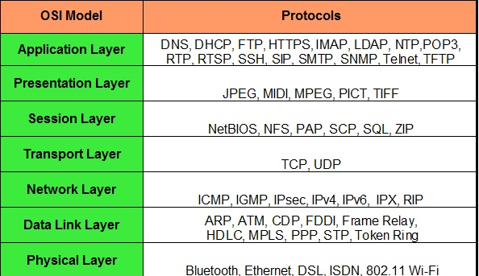

Slide 27
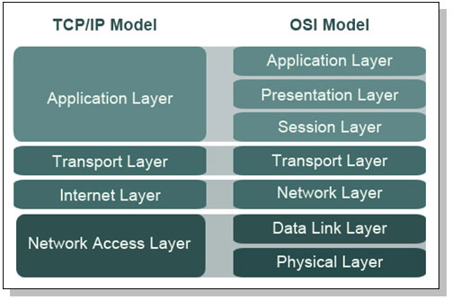
Differences TCP/OSI Model

Slide 28
TCP Tahoe To avoid congestion collapse
TCP Reno
TCP Sack
TCP Vegas congestion avoidance algorithm

Slide 29
Simple Physical Topologies
Physical topology: physical layout of nodes on a network
Three fundamental shapes:
  Bus
  Ring
  Star
May create hybrid topologies
Topology integral to type of network, cabling infrastructure, and transmission media used

Slide 30
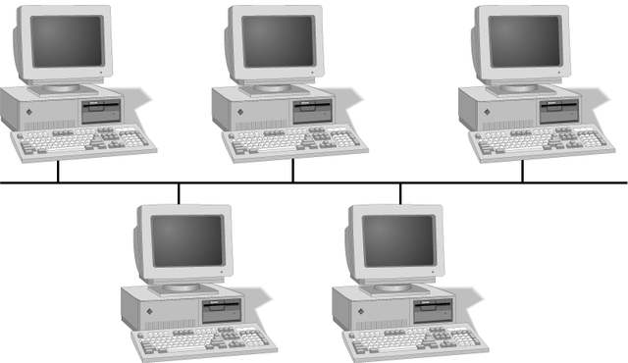
Simple Physical Topologies
Physical topology
  Physical layout of a network
A Bus topology consists of a single cable—called a bus— connecting all nodes on a network without intervening connectivity devices

Slide 31
Advantages of Bus Topology
Works well for small networks
Relatively inexpensive to implement
Easy to add to it

Slide 32
Disadvantages of Bus Topology
Management costs can be high
Potential for congestion with network traffic

Slide 33
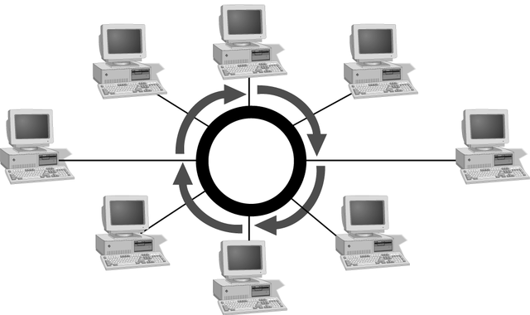
Simple Physical Topologies
Ring topology
  Each node is connected to the two nearest nodes so the entire network forms a circle
  One method for passing data on ring networks is token passing
Active topology
  Each workstation transmits data

Slide 34
Advantages of Ring Topology
Easier to manage; easier to locate a defective node or cable problem
Well-suited for transmitting signals over long distances on a LAN
Handles high-volume network traffic
Enables reliable communication

Slide 35
Disadvantages of Ring Topology
Expensive
Requires more cable and network equipment at the start
Not used as widely as bus topology
  Fewer equipment options
  Fewer options for expansion to high-speed communication

Slide 36
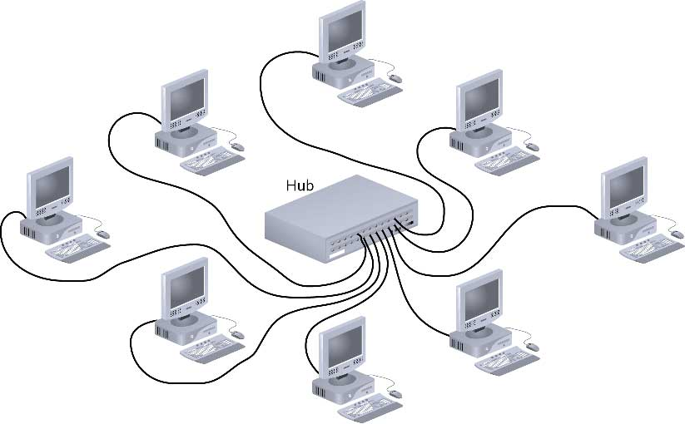
Star

Slide 37
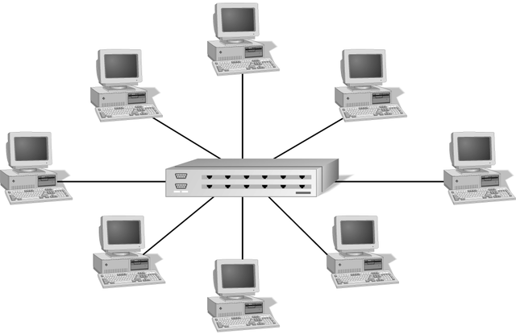
Simple Physical Topologies
Star topology
  Every node on the network is connected through a central device

Slide 38
Star (continued)
Any single cable connects only two devices
  Cabling problems affect two nodes at most
Requires more cabling than ring or bus networks
  More fault-tolerant
Easily moved, isolated, or interconnected with other networks
  Scalable
Supports max of 1024 addressable nodes on logical network

Slide 39
Advantages of Star Topology
Good option for modern networks
Low startup costs
Easy to manage
Offers opportunities for expansion
Most popular topology in use; wide variety of equipment available

Slide 40
Disadvantages of Star Topology
Hub is a single point of failure
Requires more cable than the bus

Slide 41
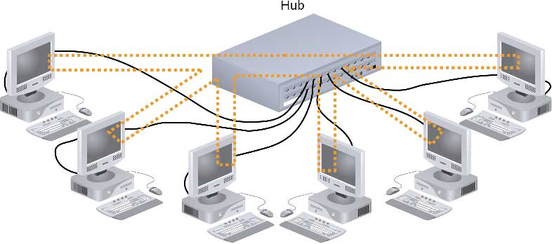
Hybrid Physical Topologies:
Star-Wired Ring

Slide 42
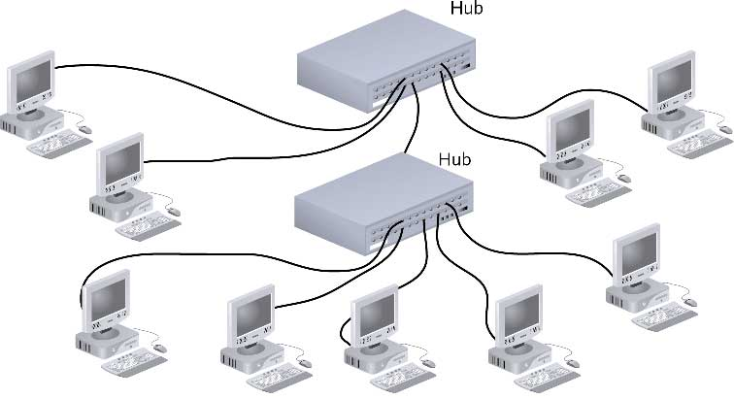
Star-Wired Bus

Slide 43
Backbone Networks: Serial Backbone
Daisy chain: linked series of devices
  Hubs and switches often connected in daisy chain to extend a network
Hubs, gateways, routers, switches, and bridges can form part of backbone
Extent to which hubs can be connected is limited

Slide 44
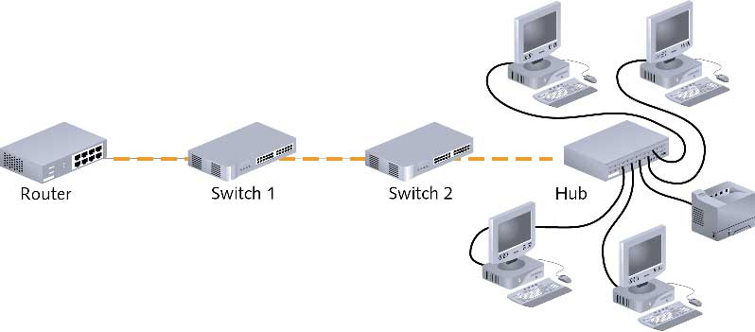
Backbone Networks: Serial Backbone (continued)

Slide 45
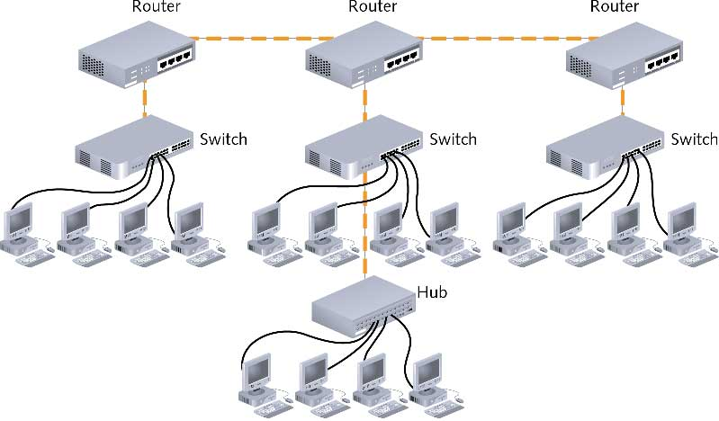
Distributed Backbone

Slide 46
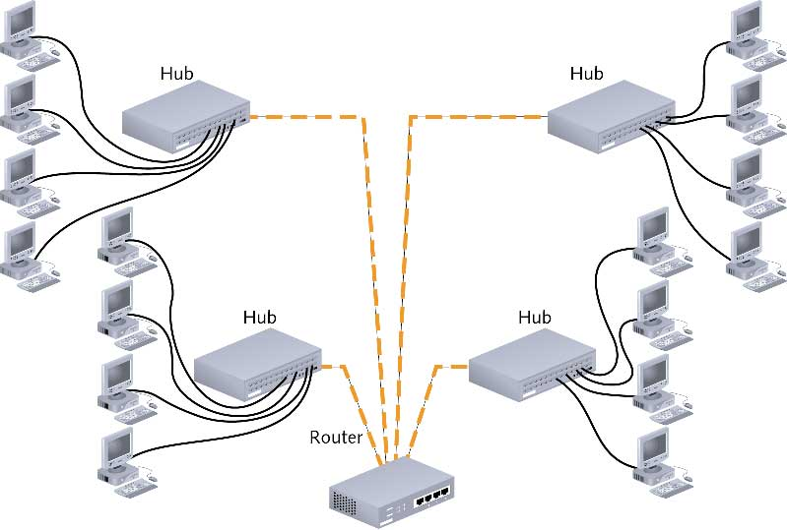
Collapsed Backbone

Slide 47
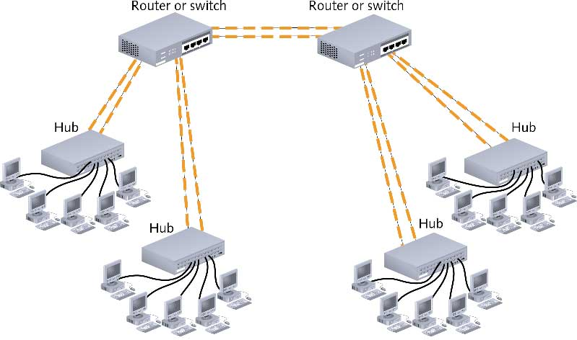
Parallel Backbone

